Slide 2
Historic Programming Languages
Fortgeschrittene Programmierkonzepte
Sandro, Toygun, Tufan

Slide 3
Konzept für ein Anfang folgt (willkürliche Bilder und Sprachen)

Slide 4
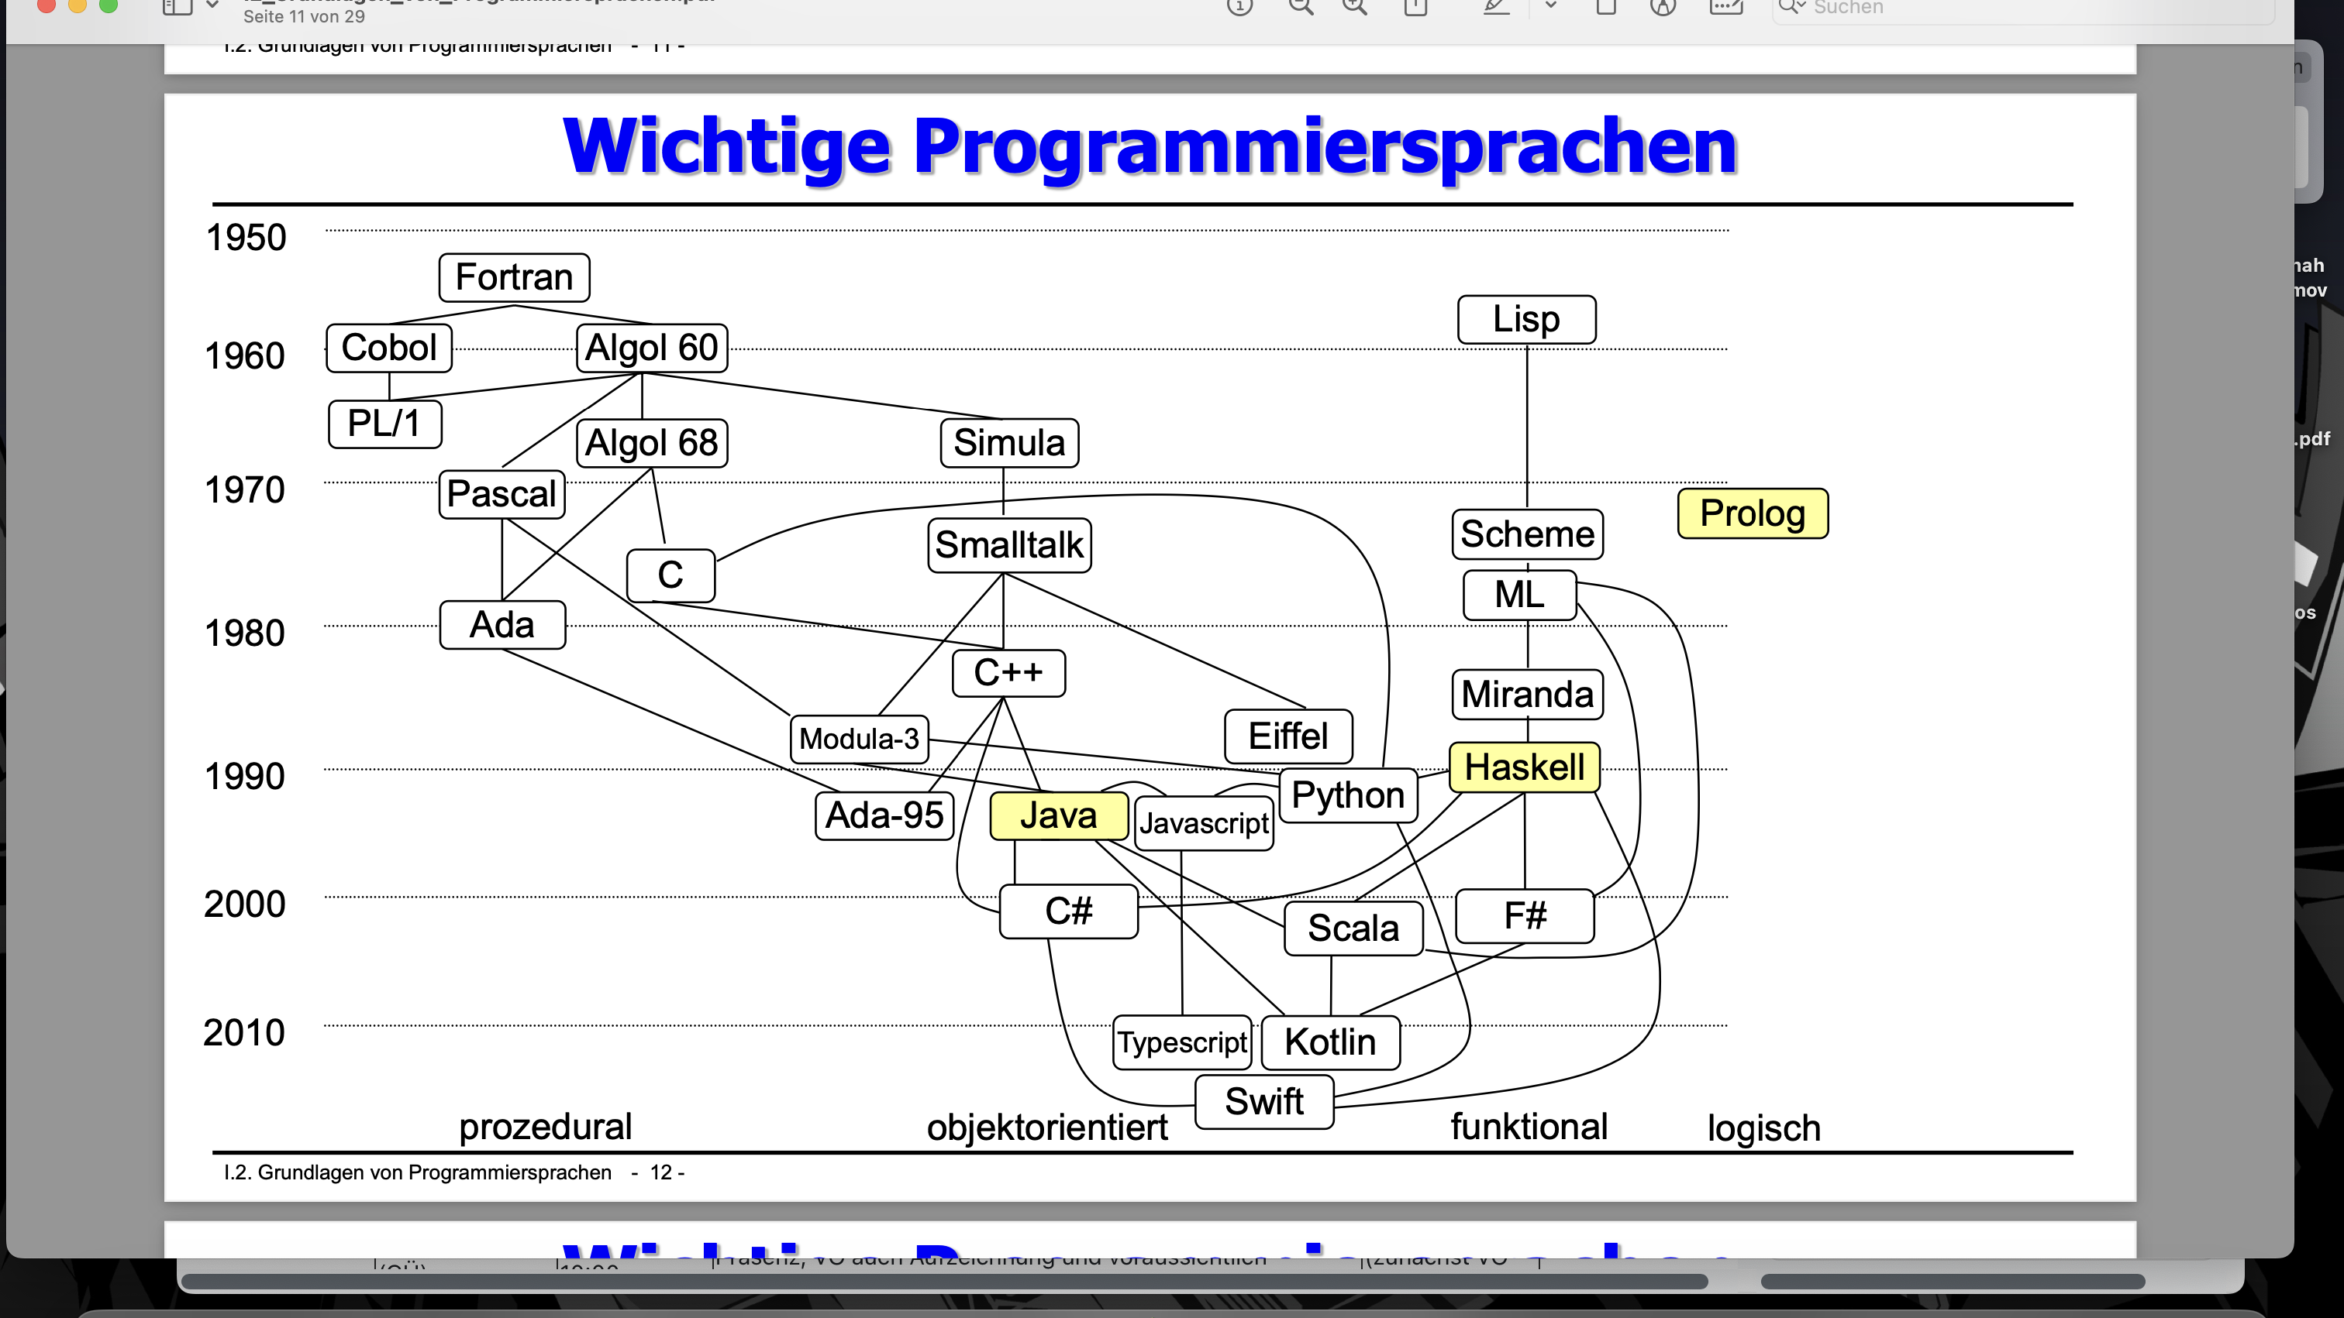
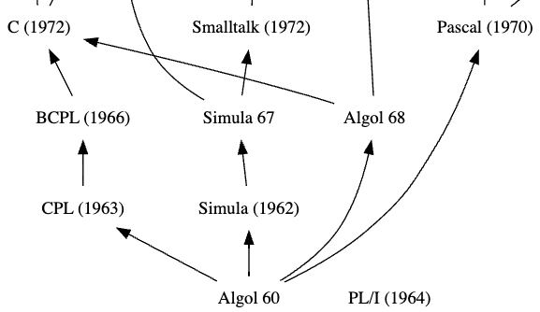

Slide 5
ALGOL
(algorithmic language)

Slide 6
ALGOL
What’s that?
ALGOL
ALGOL 58
ALGOL 68
First version of ALGOL
Numerical computing
Block structure
Much more complex
User- defined data types
ALGOL 60
More powerful
Flexible
Very influential
Recursion
Multi-dimensional arrays

Slide 7
ALGOL 60

Slide 8
ALGOL 60
History
ALGOL 60
Developed by an international comitee
Expressive and powerful
Simula (1962)
PL/1 (1964)
ALGOL 68
Pascal (1970)

Slide 9
ALGOL 60
Innovations
ALGOL 60
Recursion
Lexical scoping
Nested block structures
Semicolons as statement terminators
Clearer syntax, better to learn
Simula (1962)
PL/1 (1964)
ALGOL 68
Pascal (1970)

Slide 10
ALGOL 60
Areas of application
ALGOL 60
Algorithm development
Clear and concise
Scientific and engineering calculations
Simula (1962)
PL/1 (1964)
ALGOL 68
Pascal (1970)

Slide 11
Syntax

Slide 12
Code blocks
Syntax
begin
integer A, X;
real Z;
Z := 2.5;
Code blocks defined with begin/end
Operators: +, -, *, /, ÷, ↑
Datatypes: integer, real, boolean
A := 5;
X := 8;
outinteger(1, A + X);
outinteger(1, A * X);
outinteger(1, Z / A);
outinteger(1, X ÷ A);
outinteger(1, X ↑ A);
end
Output: 8
40
0.5
1
32768

Slide 13
Lexical Scoping
Syntax
begin
integer A, X;
comment outer X;
A := 5;
Scope of variable determined by position in code/which block
Can be accessed within block and any block nested within
Incorporated in Java, Python, JavaScript
X := 8;
begin
integer X, Y;
comment inner X;
X := 5;
comment inner X assigned here;
Y := 10;
end
outinteger(1,X);
Y := 12;
comment error! Y not defined in outer scope;
end
Output: 8

Slide 14
Arrays
Syntax
begin
procedure arrayproc(n); value n; integer n;
begin
Every array declared with one datatype
real array by default
array[start:end] ≠ Java
integer array x[0:n-1];
x[0]:=10;
x[1]:=11;
x[2]:=12;
x[3]:=13;
outstring(1,“Value at index 2: ");
outinteger(1,x[2]);
end
integer n := 4;
arrayproc(n)
end
Output: Value at index 2: 12

Slide 15
Control structures
Syntax
If-then-else
For loops
integer i, j;
integer i, j;
i := 1;
FOR i:=1 STEP 1 UNTIL 5 DO
j := 8;
begin
IF i=1 THEN outinteger(1,“I“);
FOR J:=1 STEP 1 UNTIL i DO
outstring(1,“ * ");
IF i<j THEN outstring(1,“I<j“)
end
ELSE outstring(1,“i>=j“);
Output: *
**
***
****
*****
Output: 1 i<j

Slide 16
Advantages & Disadvantages

Slide 17
Advantages
ALGOL 60
Okkkkk

Slide 18
Disadvantages
ALGOL 60
Mhhhhhhhmmm

Slide 19
Conclusion

Slide 20
Conclusion
ALGOL 60
Ah so ist das

